Slide 1
CS162
Operating Systems and
Systems Programming
Lecture 19
General I/O, Storage Devices
March 23rd, 2023
Prof. John Kubiatowicz
http://cs162.eecs.Berkeley.edu

Slide 2
Recall: Clock Algorithm (Not Recently Used)
Set of all pages
in Memory
Single Clock Hand:
  Advances only on page fault!
  Check for pages not used recently
  Mark pages as not used recently
Clock Algorithm: Arrange physical pages in circle with single clock hand
  Approximate LRU (approximation to approximation to MIN)
  Replace an old page, not the oldest page
Details:
  Hardware “use” bit per physical page (called “accessed” in Intel architecture):
    Hardware sets use bit on each reference
    If use bit isn’t set, means not referenced in a long time
    Some hardware sets use bit in the TLB; must be copied back to page TLB entry gets replaced
  On page fault:
    Advance clock hand (not real time)
    Check use bit: 1→ used recently; clear and leave alone
    0→ selected candidate for replacement

Slide 3
Recall: Second-Chance List Algorithm (VAX/VMS)
LRU victim
Directly
Mapped Pages
Marked: RW
List: FIFO
Overflow
Second
Chance List
Marked: Invalid
List: LRU
Access
Page-in
From disk
New
Active Pages
New
SC Victims
Split memory in two: Active list (RW), SC list (Invalid)
Access pages in Active list at full speed
Otherwise, Page Fault
  Always move overflow page from end of Active list to front of Second-chance list (SC) and mark invalid
  Desired Page On SC List: move to front of Active list, mark RW
  Not on SC list: page in to front of Active list, mark RW; page out LRU victim at end of SC list

Slide 4
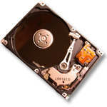
Free List
Set of all pages
in Memory
Single Clock Hand: Advances as needed to keep freelist full (“background”)
D
D
Free Pages
For Processes
Keep set of free pages ready for use in demand paging
  Freelist filled in background by Clock algorithm or other technique (“Pageout demon”)
  Dirty pages start copying back to disk when enter list
Like VAX second-chance list
  If page needed before reused, just return to active set
Advantage: faster for page fault
  Can always use page (or pages) immediately on fault

Slide 5
Reverse Page Mapping (Sometimes called “Coremap”)
When evicting a page frame, how to know which PTEs to invalidate?
  Hard in the presence of shared pages (forked processes, shared memory, …)
Reverse mapping mechanism must be very fast
  Must hunt down all page tables pointing at given page frame when freeing a page
  Must hunt down all PTEs when seeing if pages “active”
Implementation options:
  For every page descriptor, keep linked list of page table entries that point to it
    Management nightmare – expensive
  Linux: Object-based reverse mapping
    Link together memory region descriptors instead (much coarser granularity)

Slide 6
Allocation of Page Frames (Memory Pages)
How do we allocate memory among different processes?
  Does every process get the same fraction of memory? Different fractions?
  Should we completely swap some processes out of memory?
Each process needs minimum number of pages
  Want to make sure that all processes that are loaded into memory can make forward progress
  Example: IBM 370 – 6 pages to handle SS MOVE instruction:
    instruction is 6 bytes, might span 2 pages
    2 pages to handle from
    2 pages to handle to
Possible Replacement Scopes:
  Global replacement – process selects replacement frame from set of all frames; one process can take a frame from another
  Local replacement – each process selects from only its own set of allocated frames

Slide 7
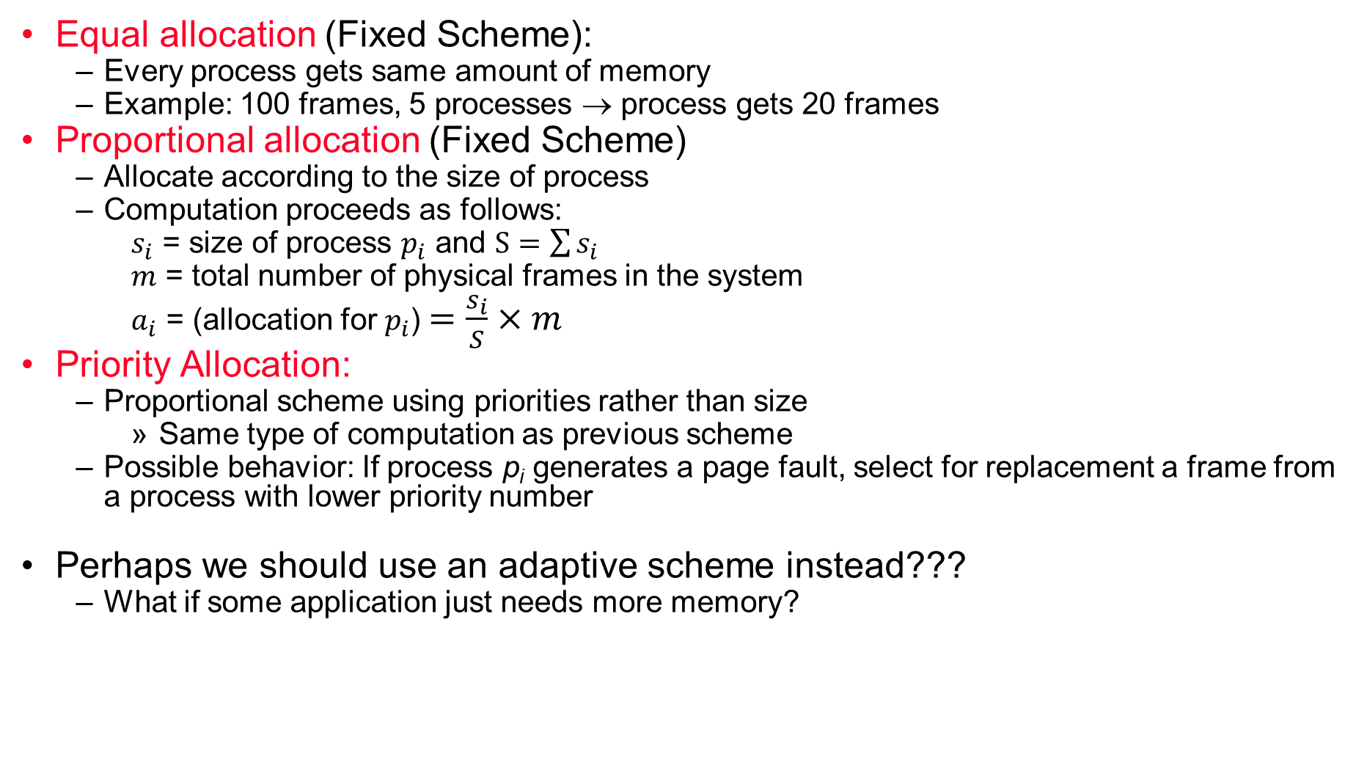
Fixed/Priority Allocation
Equal allocation (Fixed Scheme):
  Every process gets same amount of memory
  Example: 100 frames, 5 processes → process gets 20 frames
Proportional allocation (Fixed Scheme)
  Allocate according to the size of process
  Computation proceeds as follows:
  $s_{i}$ = size of process $p_{i}$ and $S=\sum{s_{i}}$
  $m$ = total number of physical frames in the system
  $a_{i}$ = (allocation for $p_{i}$)$=\frac{s_{i}}{S}×m$
Priority Allocation:
  Proportional scheme using priorities rather than size
    Same type of computation as previous scheme
  Possible behavior: If process p_{i} generates a page fault, select for replacement a frame from a process with lower priority number
Perhaps we should use an adaptive scheme instead???
  What if some application just needs more memory?

Slide 8
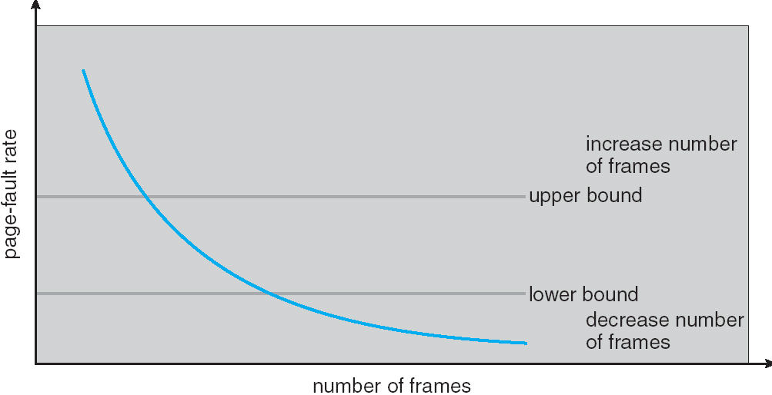
Page-Fault Frequency Allocation
Can we reduce Capacity misses by dynamically changing the number of pages/application?
Establish “acceptable” page-fault rate
  If actual rate too low, process loses frame
  If actual rate too high, process gains frame
Question: What if we just don’t have enough memory?

Slide 9
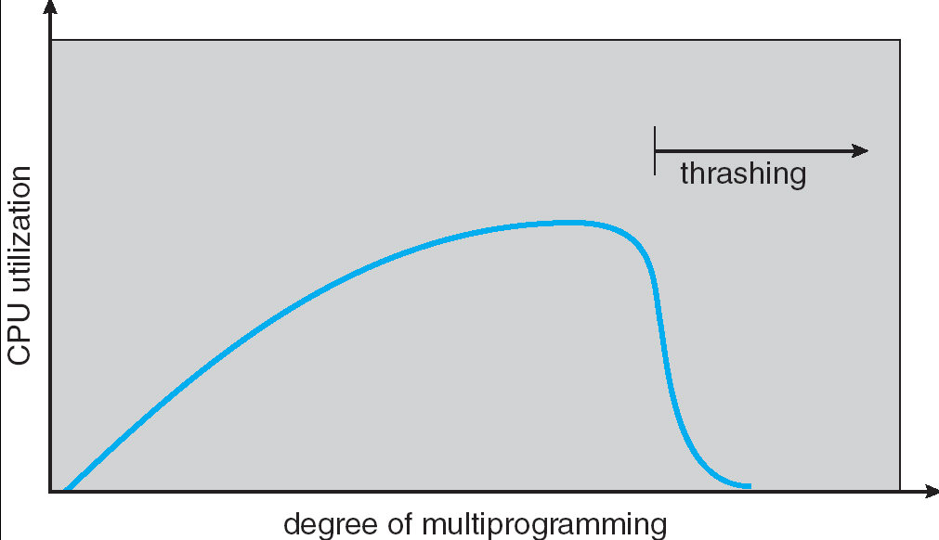
Thrashing
If a process does not have “enough” pages, the page-fault rate is very high.
This leads to:
  low CPU utilization
  operating system spends most of its time swapping to disk
Thrashing ≡ a process is busy swapping pages in and out with little or no actual progress
Questions:
  How do we detect Thrashing?
  What is best response to Thrashing?
Notes:
Example: one program, touches 50 pages (each equally likely). Have only 40 physical page frames.
How bad is this?
- Does your program run at 80% speed?
- Does your program run at 20% speed?
Performance is really bad
If we have enough pages, 200 ns/ref, but if too few pages, assume every 5th page reference causes a page fault
= 4 refs x 200 ns
1 page fault x 10 ms for disk I/O
= 5 refs, 10 ms + 800 ns => 2 ms/ref (not 100 MIPS, but 500 IPS! Factor of 10,000)
Machine appears to have stopped!

Slide 10
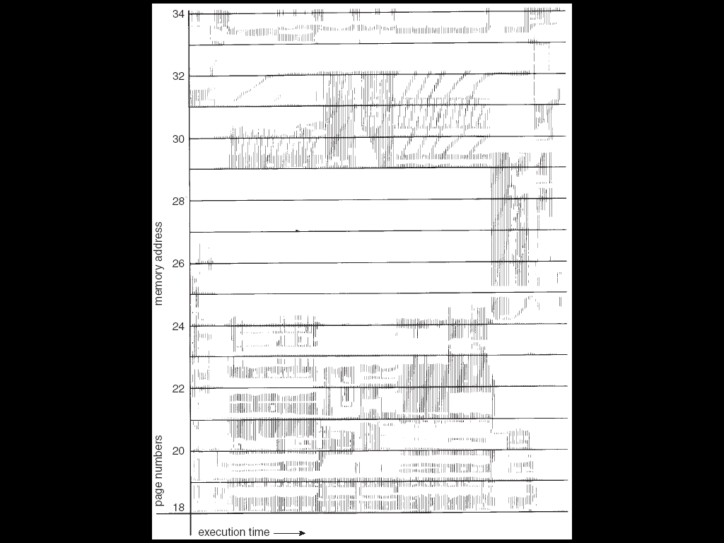
Locality In A Memory-Reference Pattern
Program Memory Access Patterns have temporal and spatial locality
  Group of Pages accessed along a given time slice called the “Working Set”
  Working Set defines minimum number of pages for process to behave well
Not enough memory for Working Set ⇒ Thrashing
  Better to swap out process?

Slide 11
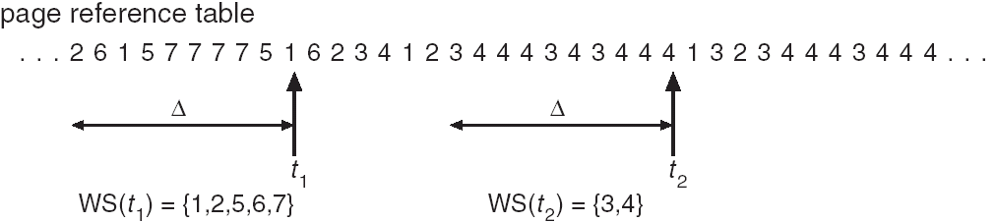
Working-Set Model
Δ ≡ working-set window ≡ fixed number of page references
  Example: 10,000 instructions
WSi (working set of Process Pi) = total set of pages referenced in the most recent Δ (varies in time)
  if Δ too small will not encompass entire locality
  if Δ too large will encompass several localities
  if Δ = ∞ ⇒ will encompass entire program
D = Σ|WSi| ≡ total demand frames
if D > m ⇒ Thrashing
  Policy: if D > m, then suspend/swap out processes
  This can improve overall system behavior by a lot!

Slide 12
What about Compulsory Misses?
Recall that compulsory misses are misses that occur the first time that a page is seen
  Pages that are touched for the first time
  Pages that are touched after process is swapped out/swapped back in
Clustering:
  On a page-fault, bring in multiple pages “around” the faulting page
  Since efficiency of disk reads increases with sequential reads, makes sense to read several sequential pages
Working Set Tracking:
  Use algorithm to try to track working set of application
  When swapping process back in, swap in working set

Slide 13
Administrivia
Still Grading Midterm 2
  Done tonight!!!
  We will release solutions at the same time that we release grades
Both Homework 4 and Project 2 are due in week after Spring break
  Don’t wait until end of Spring break!
Midterm 3: April 27
  Ok, so this is a while yet…!
Enjoy Spring Break!!!

Slide 14
Linux Memory Details?
Memory management in Linux considerably more complex than the examples we have been discussing
Memory Zones: physical memory categories
  ZONE_DMA: < 16MB memory, DMAable on ISA bus
  ZONE_NORMAL: 16MB → 896MB (mapped at 0xC0000000)
  ZONE_HIGHMEM: Everything else (> 896MB)
Each zone has 1 freelist, 2 LRU lists (Active/Inactive)
Many different types of allocation
  SLAB allocators, per-page allocators, mapped/unmapped
Many different types of allocated memory:
  Anonymous memory (not backed by a file, heap/stack)
  Mapped memory (backed by a file)
Allocation priorities
  Is blocking allowed/etc

Slide 15
Linux Virtual memory map (Pre-Meltdown)
0xFFFFFFFF
0xFFFFFFFFFFFFFFFF
Kernel
Addresses
1GB
Kernel
Addresses
128TiB
896MB
Physical
64 TiB
Physical
0xC0000000
User
Addresses
0xFFFF800000000000
3GB Total
Empty
Space
“Canonical Hole”
0x00007FFFFFFFFFFF
128TiB
User
Addresses
0x00000000
0x0000000000000000
32-Bit Virtual Address Space
64-Bit Virtual Address Space

Slide 16
Pre-Meltdown Virtual Map (Details)
Kernel memory not generally visible to user
  Exception: special VDSO (virtual dynamically linked shared objects) facility that maps kernel code into user space to aid in system calls (and to provide certain actual system calls such as gettimeofday())
Every physical page described by a “page” structure
  Collected together in lower physical memory
  Can be accessed in kernel virtual space
  Linked together in various “LRU” lists
For 32-bit virtual memory architectures:
  When physical memory < 896MB
    All physical memory mapped at 0xC0000000
  When physical memory >= 896MB
    Not all physical memory mapped in kernel space all the time
    Can be temporarily mapped with addresses > 0xCC000000
For 64-bit virtual memory architectures:
  All physical memory mapped above 0xFFFF800000000000

Slide 17
Post Meltdown Memory Map
Meltdown flaw (2018, Intel x86, IBM Power, ARM)
  Exploit speculative execution to observe contents of kernel memory
  1: // Set up side channel (array flushed from cache)
  2: uchar array[256 * 4096];
  3: flush(array); // Make sure array out of cache
  4: try { // … catch and ignore SIGSEGV (illegal access)
  5: uchar result = *(uchar *)kernel_address; // Try access!
  6: uchar dummy = array[result * 4096]; // leak info!
  7: } catch(){;} // Could use signal() and setjmp/longjmp
  8: // scan through 256 array slots to determine which loaded
  Some details:
    Reason we skip 4096 for each value: avoid hardware cache prefetch
    Note that value detected by fact that one cache line is loaded
    Catch and ignore page fault: set signal handler for SIGSEGV, can use setjump/longjmp….
Patch: Need different page tables for user and kernel
  Without PCID tag in TLB, flush TLB twice on syscall (800% overhead!)
  Need at least Linux v 4.14 which utilizes PCID tag in new hardware to avoid flushing when change address space
Fix: better hardware without timing side-channels
  Will be coming, but still in works

Slide 18
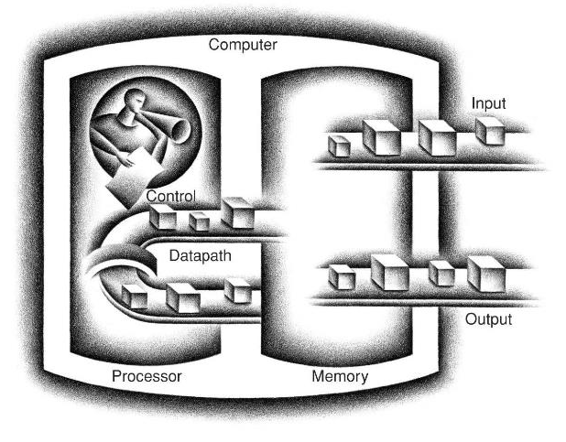
Recall: Five Components of a Computer
Diagram from “Computer Organization and Design” by Patterson and Hennessy

Slide 19
Requirements of I/O
So far in CS 162, we have studied:
  Abstractions: the APIs provided by the OS to applications running in a process
  Synchronization/Scheduling: How to manage the CPU
What about I/O?
  Without I/O, computers are useless (disembodied brains?)
  But… thousands of devices, each slightly different
    How can we standardize the interfaces to these devices?
  Devices unreliable: media failures and transmission errors
    How can we make them reliable???
  Devices unpredictable and/or slow
    How can we manage them if we don’t know what they will do or how they will perform?

Slide 20
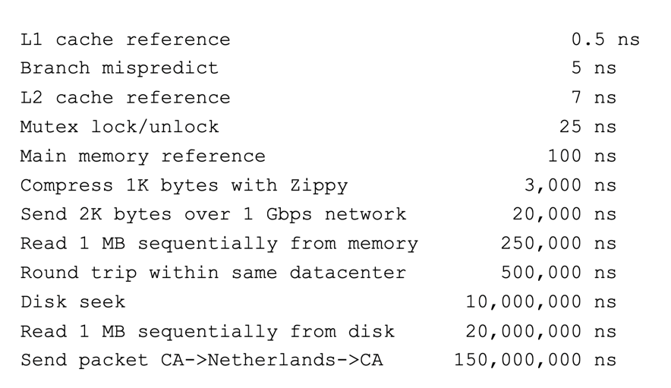
Recall: Range of Timescales
Jeff Dean: “Numbers Everyone Should Know”

Slide 21
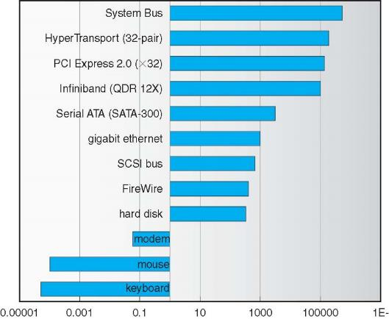
Example: Device Transfer Rates in Mb/s (Sun Enterprise 6000)
Device rates vary over 12 orders of magnitude!!!
System must be able to handle this wide range
  Better not have high overhead/byte for fast devices
  Better not waste time waiting for slow devices

Slide 22

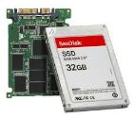
In a Picture
Read / Write
wires
Processor
I/O
Controllers
Core
L2 Cache
Secondary
Storage
(Disk)
Registers
L1 Cache
interrupts
Secondary
Storage
(SSD)
Main
Memory
(DRAM)
L3 Cache
(shared)
Read / Write
DMA transfer
Core
L2 Cache
Registers
L1 Cache
I/O devices you recognize are supported by I/O Controllers
Processors accesses them by reading and writing IO registers as if they were memory
  Write commands and arguments, read status and results

Slide 23
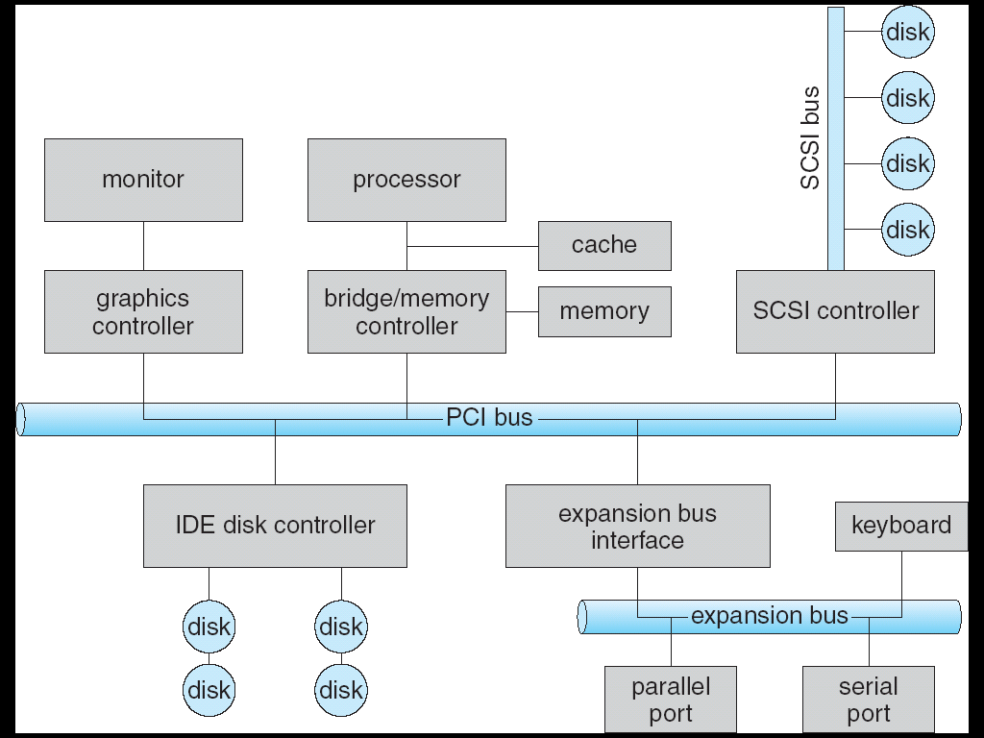
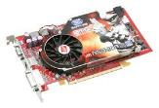
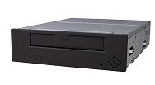



Modern I/O Systems
network

Slide 24
What’s a bus?
Common set of wires for communication among hardware devices plus protocols for carrying out data transfer transactions
  Operations: e.g., Read, Write
  Control lines, Address lines, Data lines
  Typically multiple devices
Protocol: initiator requests access, arbitration to grant, identification of recipient, handshake to convey address, length, data
Very high BW close to processor (wide, fast, and inflexible), low BW with high flexibility out in I/O subsystem

Slide 25
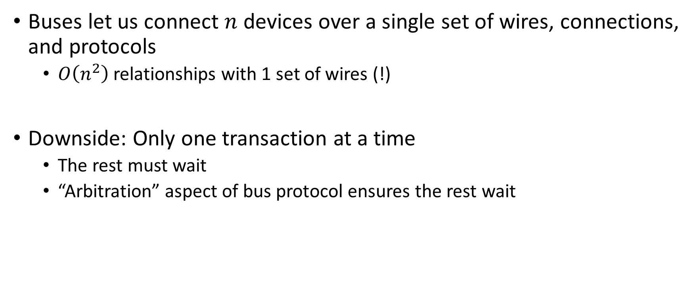
Why a Bus?
Buses let us connect $n$ devices over a single set of wires, connections, and protocols
  $O\left(n^{2}\right)$ relationships with 1 set of wires (!)
Downside: Only one transaction at a time
  The rest must wait
  “Arbitration” aspect of bus protocol ensures the rest wait

Slide 26
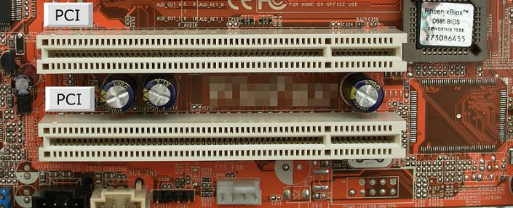
PCI Bus Evolution
PCI started life out as a bus
But a parallel bus has many limitations
  Multiplexing address/data for many requests
  Slowest devices must be able to tell what’s happening (e.g., for arbitration)
  Bus speed is set to that of the slowest device

Slide 27
PCI Express “Bus”
No longer a parallel bus
Really a collection of fast serial channels or “lanes”
Devices can use as many as they need to achieve a desired bandwidth
Slow devices don’t have to share with fast ones
One of the successes of device abstraction in Linux was the ability to migrate from PCI to PCI Express
  The physical interconnect changed completely, but the old API still worked

Slide 28
Example: PCI Architecture
RAM
Memory
Bus
CPU
Host Bridge
PCI #0
ISA Bridge
PCI Bridge
PCI #1
ISA
Controller
PCI Slots
USB
Controller
SATA
Controller
Scanner
Legacy
Devices
Root Hub
Hard Disk
DVD ROM
Hub
Webcam
Mouse
Keyboard

Slide 29
How does the Processor Talk to the Device?
Processor Memory Bus
Regular
Memory
CPU
Bus
Adaptor
Bus
Adaptor
Device
Controller
Address +
Data
Other Devices
or Buses
Bus
Interface
Hardware
Controller
Interrupt
Controller
Interrupt Request
read
Addressable
Memory
and/or
Queues
write
control
CPU interacts with a Controller
  Contains a set of registers that can be read and written
  May contain memory for request queues, etc.
Processor accesses registers in two ways:
  Port-Mapped I/O: in/out instructions
    Example from the Intel architecture: out 0x21,AL
  Memory-mapped I/O: load/store instructions
    Registers/memory appear in physical address space
    I/O accomplished with load and store instructions
status
Registers
(port 0x20)
Memory Mapped
Region: 0x8f008020

Slide 30
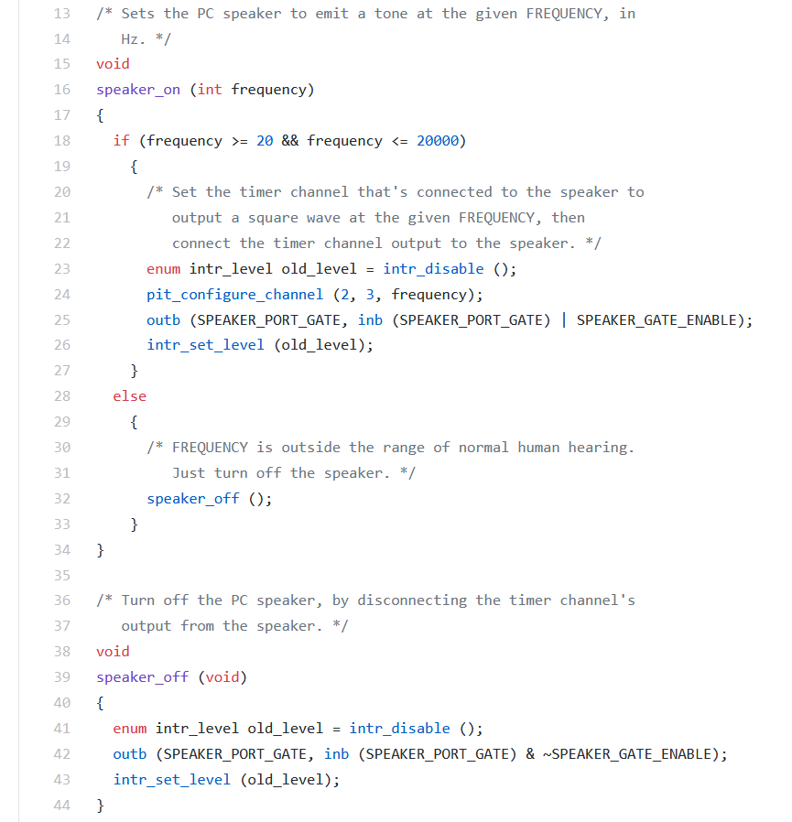
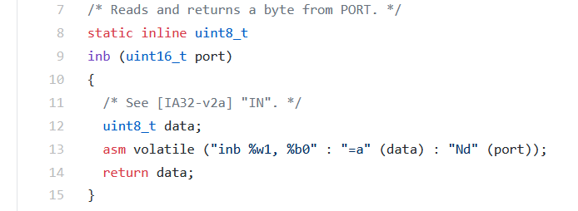
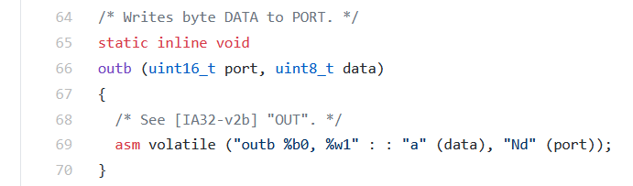
Port-Mapped I/O in Pintos Speaker Driver
Pintos: devices/speaker.c
Pintos: threads/io.h

Slide 31
Example: Memory-Mapped Display Controller
Memory-Mapped:
  Hardware maps control registers and display memory into physical address space
    Addresses set by HW jumpers or at boot time
  Simply writing to display memory (also called the “frame buffer”) changes image on screen
    Addr: 0x8000F000 — 0x8000FFFF
  Writing graphics description to cmd queue
    Say enter a set of triangles describing some scene
    Addr: 0x80010000 — 0x8001FFFF
  Writing to the command register may cause on-board graphics hardware to do something
    Say render the above scene
    Addr: 0x0007F004
Can protect with address translation
0x80020000
Graphics
Command
Queue
0x80010000
Display
Memory
0x8000F000
0x0007F004
Command
0x0007F000
Status
Physical
Address
Space

Slide 32
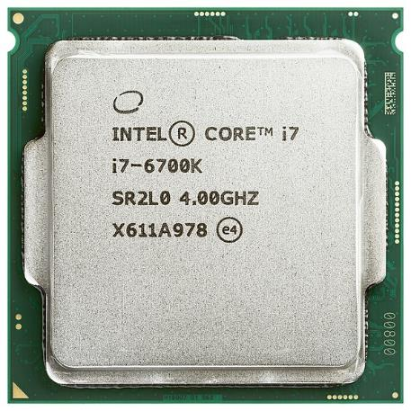
There’s more than just a CPU in there!

Slide 33
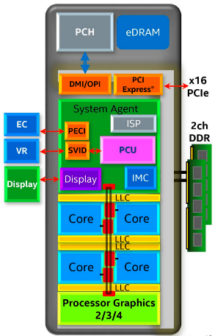
Chip-scale Features of 2015 x86 (Sky Lake)
Significant pieces:
  Four OOO cores with deeper buffers
    Intel MPX (Memory Protection Extensions)
    Intel SGX (Software Guard Extensions)
    Issue up to 6 μ-ops/cycle
  GPU, System Agent (Mem, Fast I/O)
  Large shared L3 cache with on-chip ring bus
    2 MB/core instead of 1.5 MB/core
    High-BW access to L3 Cache
Integrated I/O
  Integrated memory controller (IMC)
    Two independent channels of DRAM
  High-speed PCI-Express (for Graphics cards)
  Direct Media Interface (DMI) Connection to PCH (Platform Control Hub)
Notes:
Let’s look at I/O in a modern processor.

Slide 34
Sky Lake I/O: PCH
Platform Controller Hub
  Connected to processor with proprietary bus
    Direct Media Interface
Types of I/O on PCH:
  USB, Ethernet
  Thunderbolt 3
  Audio, BIOS support
  More PCI Express (lower speed than on Processor)
  SATA (for Disks)
Sky Lake
System Configuration

Slide 35
Operational Parameters for I/O
Data granularity: Byte vs. Block
  Some devices provide single byte at a time (e.g., keyboard)
  Others provide whole blocks (e.g., disks, networks, etc.)
Access pattern: Sequential vs. Random
  Some devices must be accessed sequentially (e.g., tape)
  Others can be accessed “randomly” (e.g., disk, cd, etc.)
    Fixed overhead to start transfers
  Some devices require continual monitoring
  Others generate interrupts when they need service
Transfer Mechanism: Programmed IO and DMA

Slide 36
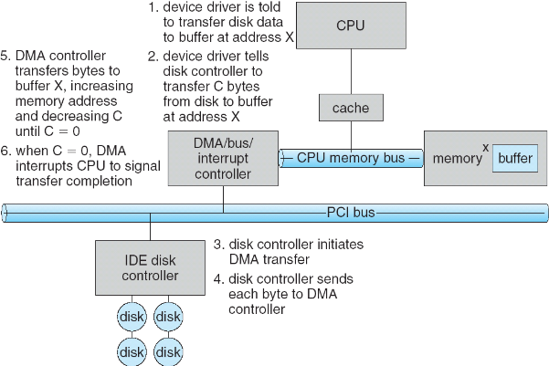
Transferring Data To/From Controller
Programmed I/O:
  Each byte transferred via processor in/out or load/store
  Pro: Simple hardware, easy to program
  Con: Consumes processor cycles proportional to data size
Direct Memory Access:
  Give controller access to memory bus
  Ask it to transfer
  data blocks to/from
  memory directly
Sample interaction with DMA controller
(from OSC book):
1
2
3

Slide 37
Transferring Data To/From Controller
Programmed I/O:
  Each byte transferred via processor in/out or load/store
  Pro: Simple hardware, easy to program
  Con: Consumes processor cycles proportional to data size
Direct Memory Access:
  Give controller access to memory bus
  Ask it to transfer
  data blocks to/from
  memory directly
Sample interaction with DMA controller
(from OSC book):
6
5
4

Slide 38
I/O Device Notifying the OS
The OS needs to know when:
  The I/O device has completed an operation
  The I/O operation has encountered an error
I/O Interrupt:
  Device generates an interrupt whenever it needs service
  Pro: handles unpredictable events well
  Con: interrupts relatively high overhead
Polling:
  OS periodically checks a device-specific status register
    I/O device puts completion information in status register
  Pro: low overhead
  Con: may waste many cycles on polling if infrequent or unpredictable I/O operations
Actual devices combine both polling and interrupts
  For instance – High-bandwidth network adapter:
    Interrupt for first incoming packet
    Poll for following packets until hardware queues are empty
Notes:
After the OS has issued a command to the I/O device either via a special I/O instruction or by writing to a location in the I/O address space, the OS needs to be notified when:
(a) The I/O device has completed the operation.
(b) Or when the I/O device has encountered an error.
This can be accomplished in two different ways: Polling and I/O interrupt.
+1 = 58 min. (Y:38)

Slide 39

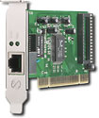
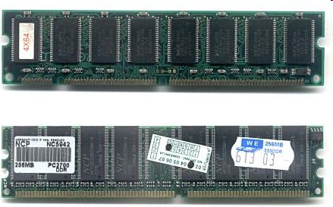
Kernel Device Structure
The System Call Interface
Process
Management
Memory
Management
Filesystems
Device
Control
Networking
Concurrency,
multitasking
Virtual
memory
Files and dirs:
the VFS
TTYs and
device access
Connectivity
Architecture
Dependent
Code
Memory
Manager
File System Types
Device
Control
Network
Subsystem
Block
Devices
IF drivers

Slide 40
Recall: Device Drivers
Device Driver: Device-specific code in the kernel that interacts directly with the device hardware
  Supports a standard, internal interface
  Same kernel I/O system can interact easily with different device drivers
  Special device-specific configuration supported with the ioctl() system call
Device Drivers typically divided into two pieces:
  Top half: accessed in call path from system calls
    implements a set of standard, cross-device calls like open(), close(), read(), write(), ioctl(), strategy()
    This is the kernel’s interface to the device driver
    Top half will start I/O to device, may put thread to sleep until finished
  Bottom half: run as interrupt routine
    Gets input or transfers next block of output
    May wake sleeping threads if I/O now complete

Slide 41
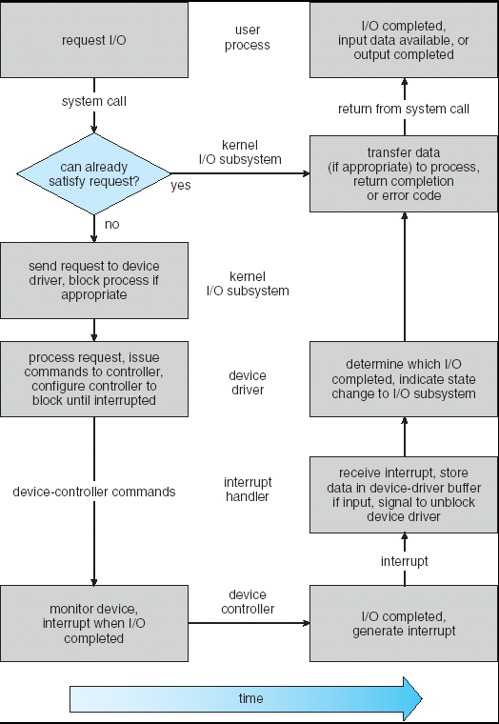
Recall: Life Cycle of An I/O Request
User
Program
Kernel I/O
Subsystem
Device Driver
Top Half
Device Driver
Bottom Half
Device
Hardware

Slide 42
The Goal of the I/O Subsystem
Provide Uniform Interfaces, Despite Wide Range of Different Devices
  This code works on many different devices:
  FILE fd = fopen("/dev/something", "rw");
  for (int i = 0; i < 10; i++) {
  fprintf(fd, "Count %d\n", i);
  }
  close(fd);
  Why? Because code that controls devices (“device driver”) implements standard interface
We will try to get a flavor for what is involved in actually controlling devices in rest of lecture
  Can only scratch surface!

Slide 43
Want Standard Interfaces to Devices
Block Devices: e.g. disk drives, tape drives, DVD-ROM
  Access blocks of data
  Commands include open(), read(), write(), seek()
  Raw I/O or file-system access
  Memory-mapped file access possible
Character Devices: e.g. keyboards, mice, serial ports, some USB devices
  Single characters at a time
  Commands include get(), put()
  Libraries layered on top allow line editing
Network Devices: e.g. Ethernet, Wireless, Bluetooth
  Different enough from block/character to have own interface
  Unix and Windows include socket interface
    Separates network protocol from network operation
    Includes select() functionality
  Usage: pipes, FIFOs, streams, queues, mailboxes

Slide 44
How Does User Deal with Timing?
Blocking Interface: “Wait”
  When request data (e.g. read() system call), put process to sleep until data is ready
  When write data (e.g. write() system call), put process to sleep until device is ready for data
Non-blocking Interface: “Don’t Wait”
  Returns quickly from read or write request with count of bytes successfully transferred
  Read may return nothing, write may write nothing
Asynchronous Interface: “Tell Me Later”
  When request data, take pointer to user’s buffer, return immediately; later kernel fills buffer and notifies user
  When send data, take pointer to user’s buffer, return immediately; later kernel takes data and notifies user

Slide 45
Conclusion
I/O Devices Types:
  Many different speeds (0.1 bytes/sec to GBytes/sec)
  Different Access Patterns:
    Block Devices, Character Devices, Network Devices
  Different Access Timing:
    Blocking, Non-blocking, Asynchronous
I/O Controllers: Hardware that controls actual device
  Processor Accesses through I/O instructions, load/store to special physical memory
Notification mechanisms
  Interrupts
  Polling: Report results through status register that processor looks at periodically
Device drivers interface to I/O devices
  Provide clean Read/Write interface to OS above
  Manipulate devices through PIO, DMA & interrupt handling
  Three types: block, character, and network

